Slide 1

Summary of Risks of Maternal and Newborn Hyperthermia
The risks described below are primarily associated with significant and sustained maternal hyperthermia during early embryonic development, rather than ordinary exposure to a single hot day. Risk varies according to the intensity and duration of exposure, hydration, air quality, underlying health conditions and access to cooling and care.
Stage
Main maternal risks
Main risks for the fetus or newborn
Key risk window
First
trimester
Dehydration and cardiovascular strain
Disruption of early placental development
Increased risk of developing hypertensive disorders later in pregnancy
Congenital anomalies associated with significant, sustained maternal hyperthermia
Impaired placental development
Early embryonic development, particularly weeks 3–8 after conception, and early placentation.
Second
trimester
Impaired glucose regulation and increased risk of developing gestational diabetes
Dehydration
Hypertensive disorders; Reduced uteroplacental blood flow
Congenital anomalies associated with significant, sustained maternal hyperthermia
Impaired placental development
Early embryonic development, particularly weeks 3–8 after conception, and early placentation.
Severe dehydration
Heat illness
Preterm labour
Worsening hypertension or pre-eclampsia
Increased risk of placental abruption
Increased risk of renal, cardiovascular or respiratory complications
Preterm birth
Fetal distress or hypoxia
Fetal growth restriction
Low birth weight
Increased risk of stillbirth or perinatal mortality
Prolonged heatwaves and acute heat exposure during the days immediately preceding labour
Third
trimester
Labour and
birth
Dehydration and electrolyte imbalance
Heat exhaustion or heatstroke
Worsening pre-eclampsia
Cardiovascular and respiratory strain
Maternal hypoxia
Fetal distress or hypoxia
Low Apgar scores
Complications related to placental abruption or prematurity
During labour, when fluid, cardiovascular, respiratory and thermoregulatory demands are already elevated
Postnatal and
newborn period
Dehydration and heat illness during recovery from birth
Increased hydration needs, particularly during breastfeeding
Overheating and dehydration
Impaired temperature regulation, particularly among preterm and low-birth-weight newborns
complications resulting from prematurity
Low birth weight or antenatal hypoxia
The first days and weeks after birth, particularly where access to cooling, safe water or appropriate newborn care is limited.
Across all stages: Repeated heat exposure can cause dehydration, inflammation and reduced placental blood flow. Exposure to extreme heat alongside air pollution or wildfire smoke may further increase the risk of hypertensive disorders, respiratory distress, fetal growth restriction, preterm birth, stillbirth and maternal or perinatal mortality. Women with asthma, cardiovascular disease, hypertension, diabetes or limited access to cooling may be particularly vulnerable.

Slide 2
Recognising and Responding to Heat-Related Illness in Pregnant Women
Possible heat exhaustion
Possible heat stroke — medical emergency
Signs and symptoms
Emergency signs
Headache
Dizziness or light-headedness
Weakness or unusual tiredness
Nausea or loss of appetite
Intense thirst
Heavy sweating
Cool, pale or clammy skin
Muscle cramps
Reduced urination
Confusion, unusual behaviour or slurred speech
Extreme drowsiness or difficulty responding
Seizures or loss of consciousness
Very high body temperature
Hot skin, which may be dry or sweaty
Rapid, shallow breathing
Rapid heartbeat
What to do
What to do
Stop all activity and move to a cool, shaded or air-conditioned place.
Loosen tight clothing and remove unnecessary layers.
If fully alert and not vomiting, offer frequent sips of cool water or oral rehydration solution.
Cool the skin using damp cloths, water and a fan. Place cool packs wrapped in cloth around the neck, armpits and groin.
Do not leave the woman alone.
Seek medical advice if symptoms worsen, vomiting prevents drinking or she does not improve within 30 minutes.
Call emergency services immediately.
Move the woman to a cool place and remove unnecessary clothing.
Begin rapid cooling while waiting for help: wet the skin and use a fan, or apply cool, wet cloths and wrapped cold packs to the neck, armpits and groin.
If she is unconscious but breathing, place her safely on her side—preferably her left side in later pregnancy—and monitor her breathing.
Do not give anything by mouth if she is confused, vomiting, having a seizure or not fully conscious.
Stay with her until help arrives.
Pregnancy-specific warning signs: Regular contractions or persistent uterine cramping, vaginal bleeding, fluid leaking from the vagina, or a noticeable reduction in fetal movements once movements are usually felt require urgent maternity assessment—even if the heat-related symptoms improve.

Slide 3
Recognising and Responding to Overheating and Heat-Related Illness in Newborns Newborns
Possible overheating or dehydration
Danger signs requiring urgent medical assessment
Possible signs
Danger signs
Skin feels unusually warm
Irritability or unusual restlessness
Sleepiness or reduced activity
Feeding less effectively than usual
Dry mouth or lips
Fewer wet nappies than usual
Heat rash
Temperature of 38°C or higher, or below 35.5°C
Difficult to wake, floppy or unresponsive
Unable to feed or markedly weaker feeding
Weak or absent cry
Rapid or difficult breathing, grunting or severe chest indrawing
Seizures
Persistent vomiting
Loss of consciousness
What to do
Move the baby to a cooler, well-ventilated place.
Remove excess blankets and clothing, leaving one light layer.
Measure the baby’s temperature with a digital thermometer.
Offer breast milk or formula more frequently. Do not give plain water to a baby under six months.
Monitor feeding, alertness and wet nappies closely.
Seek medical advice if the baby does not improve promptly or if you are concerned.
What to do
Arrange urgent medical assessment immediately.
Call emergency services if the baby is unresponsive, having a seizure or experiencing severe breathing difficulties.
While arranging help, move the baby away from the heat and remove excess layers.
Do not force breast milk, formula or water into the mouth of a baby who is vomiting, seizing, unresponsive or not fully conscious.
Assessment across skin tones: Changes such as pallor or flushing may be less visible on darker skin tones. Do not rely on skin colour alone. Check the baby’s temperature, breathing, alertness, feeding, mouth and wet nappies.

Slide 4
Signs of Dehydration
Signs and symptoms of dehydration in pregnancy and the postnatal period
Signs and symptoms of dehydration for newborns and infants
Cold, clammy skin
Dizziness or feeling lightheaded
Rapid heart rate
Excessive sweating or an inability to sweat
Fatigue
Headache
Muscle cramps or spasms
Nausea
Abdominal cramping
Swelling in extremities
Darker colour urine
Infrequent urination
Excessive thirst
Preterm contractions
Decreased urination (fewer than 4 wet diapers in 24 hours)
Being extra thirsty
Heavy sweating followed by no sweating at all, the skin is hot, dry and flushed
Seeming more fussy than normal
No tears when crying
Dry mouth and tongue
Tachycardia (fast heartbeat)
Shallow breathing (especially with infants)
Sunken eyes
Sunken soft spot on the head (fontanelle)

Slide 5
Protecting Mothers and Babies From Extreme Heat
Stage
During Pregnancy
During Labour & Birth
After Birth (Recovery)
Breast-feeding
Newborn cooling
Remember B.E.A.T. the Heat:
Beverages (drink water often, before feeling thirsty),
Environmental cooling (shade, wet cloths, avoid direct sun),
Activity adjustment (do chores in early morning or evening),
Take action if warning signs appear (headache, dizziness, baby moving less than usual)
Avoid hot baths and midday sun, especially in early pregnancy
Some common medicines can make it harder for the body to cool itself. These can include antihistamines and blood pressure medication. It’s worth reviewing these with a midwife or health professional
Check daily weather and heat alerts, and plan outdoor activities around cooler hours
Check the Air Quality Index (AQI). If it’s above 100, stay indoors more, close windows, and avoid smoke sources like candles or indoor cooking fires. Use air purifiers with HEPA filters or MERV13 where available for indoors and respirator masks (not surgical or cloth masks) for outdoors.
Simple homemade rehydration drinks (water with the right amount of salt and sugar or lemon) are better than sugary store-bought drinks
Women in labour should drink plenty of fluids in hot weather, roughly a cup to two cups every hour
If a mother is overheated, her baby’s heart rate should be checked more frequently, since heat stress affects the baby faster than the mother
Cool, damp cloths on the forehead, neck, and chest, plus a water spray bottle, help keep both mother and baby safe
Keep healing wounds (tears, incisions) clean and dry.
Heat and sweat can encourage bacteria to grow, so loose, breathable cotton clothing is best
Heat and dehydration raise the risk of dangerous blood clots after birth, so gentle movement and steady fluid intake are important
New mothers need about 2.5 to 3 litres of fluids a day to recover well, whether or not they’re breastfeeding
Drink water every time you breastfeed. Keep a large cup or bottle of water nearby, and drink some each time you breastfeed. Your body needs to replace fluids quickly to keep making milk.
Breast milk is enough, even in the heat. It’s about 88% water, so it fully hydrates your baby under 6 months old, even on the hottest days. You don’t need to give your baby plain water, tea, or formula. In fact,
it’s best to avoid these, and only offer breastmilk, since these other liquids can carry germs that cause diarrhoea in young babies.
Check that your baby is getting enough milk. From day 5 onward after birth, your baby should have at least 6 heavy, wet diapers in 24 hours. Your baby should also seem alert and suck strongly while feeding. These are good signs they’re getting enough fluid.
Keep clothing to one thin layer. In a hot room, dress your baby in just
one thin layer of loose cotton, or even just a diaper. Avoid the urge to wrap, swaddle, or bundle your baby up. This traps heat and stops it from escaping.
During very hot weather, place a thin, dry cotton cloth between your chest and your baby’s chest. This is a way to adapt skin-to-skin contact for extreme heat, and is still very good for your baby. The cloth helps prevent your baby from getting too much heat from your body, along with preventing rashes or discomfort from sweat.
Cool your baby gently if they seem too hot. Watch for signs like a hot chest or belly, red skin, fast breathing, or unusual sleepiness. If you notice these, gently wipe your baby’s arms, legs, and body with a cloth dampened in lukewarm (not cold) water. Letting it evaporate helps cool their skin naturally.
Never put an overheated baby into cold water. This can cause a dangerous shock response in their body.
Advice

Slide 6
Strategies to Keep a Newborn Cool
Offer breast milk or correctly prepared formula more frequently. Do not dilute formula or give the newborn plain water unless specifically advised by a qualified health professional.
Dress newborns in light, loose fitting clothing, or even just a diaper
Give cool baths before bedtime
If carrying newborns close to your body, remember to use lightweight fabric and know baby is receiving your heat as well
Seek public places that are cooler than your home, e.g. cooling centres, public buildings etc.
Generally
Stay indoors when the sun is at its highest (usually between 10-15h)
Keep newborns in the shade and out of direct sunlight
Use a broad brimmed hat when carrying newborns, or a parasol if using a buggy
Do not cover buggies with cloth or blankets, as this can make the temperature rise inside
Outdoors
Turn off electrical equipment and lights that can heat the home
Close windows and blinds/curtains during the day to keep the room cool
Keep windows open at night if it is safe
Keep doors open to help air move, if it is safe
Use a fan or air conditioner to move air, but ensure it is not aimed at the newborn
In the home

Slide 7
Air Quality and Pregnancy
Air Quality Index (AQI) Value
How to Respond
1-50
Good
Enjoy normal outdoor and indoor activities
51-100
Moderate
Spend less time outdoors if possible
If you are coughing or feel unwell, stay indoors
101-150
Unhealthy for Pregnancy
Reduce or avoid outdoor exercise
Plan outdoor activities in the morning, when the air quality is better
151-200
Unhealthy for All
Significantly reduce or avoid outdoor exercise
Plan outdoor activities when the air quality is better
201-300
Very Unhealthy for All
Avoid being outdoors

Slide 8

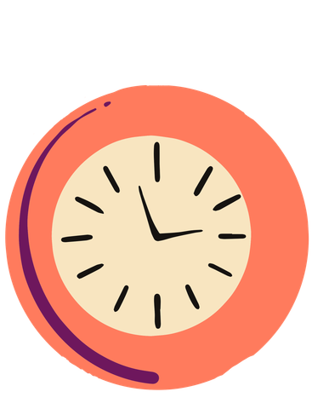


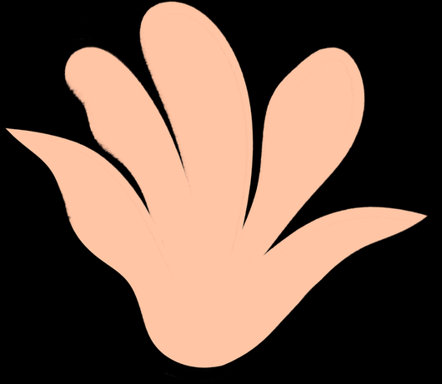



The UNICEF "B.E.A.T. the Heat" framework
Teach women and community health workers to spot risks early:
B
E
A
T
Drink Beverages
(safe water) constantly before thirst sets in.
Environmental cooling (seek shade, use wet cloths, avoid direct sun).
Activity adjustment
(shift heavy chores to early mornings/evenings)
Take action if warning signs appear (headache, dizziness, reduced fetal movement)

